Slide 1
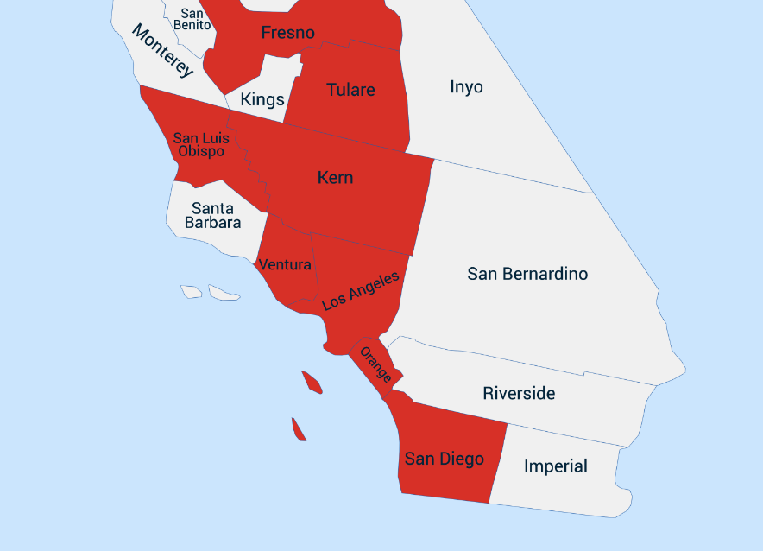
Valley Fever
Environmental
Austin, Le, Félix, Sanaa

Slide 2
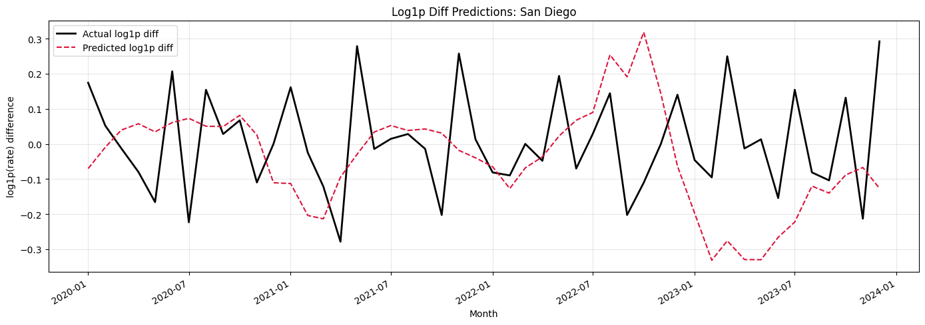
Actual vs Predicted Monthly Rate Changes
January 2020–December 2023 | Log-transformed Differences | Aggregate-trained LSTM
RMSE - 0.2095 MAE - 0.1661
Notes:
predictions have not been converted back to the original, This graph shows actual and predicted monthly changes in the transformed rate.
I have been working on the aggregate trained LSTM and testing it on the individual counties . After doing the log1p transformed diff we have seen improvement in all models. The reason were plotting log diff preds is because we encountered problems with data leakage during the back transformation, so that’s something we’ll be working on. We didn't calculate rate using the diff.

Slide 3
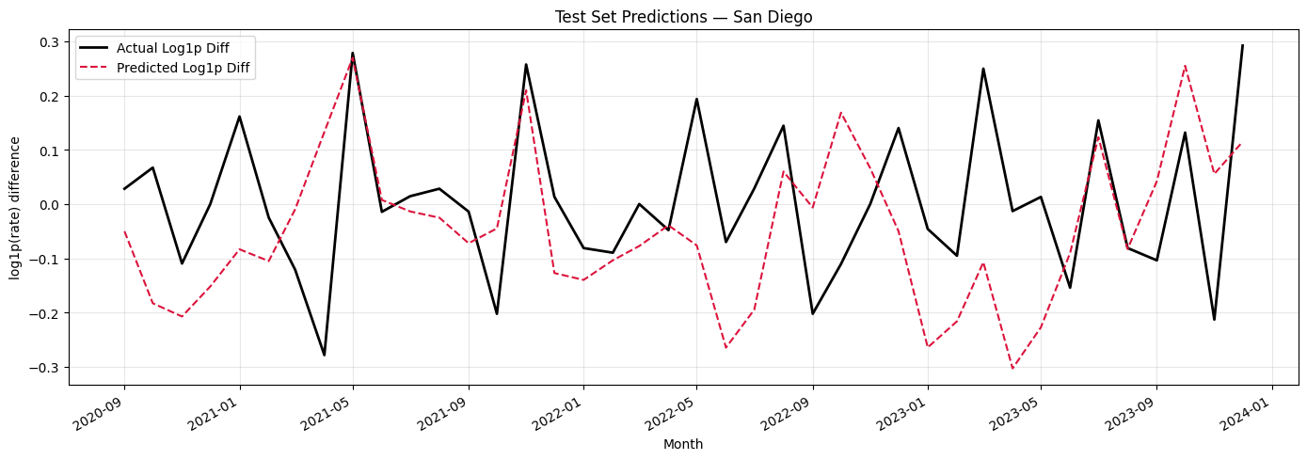
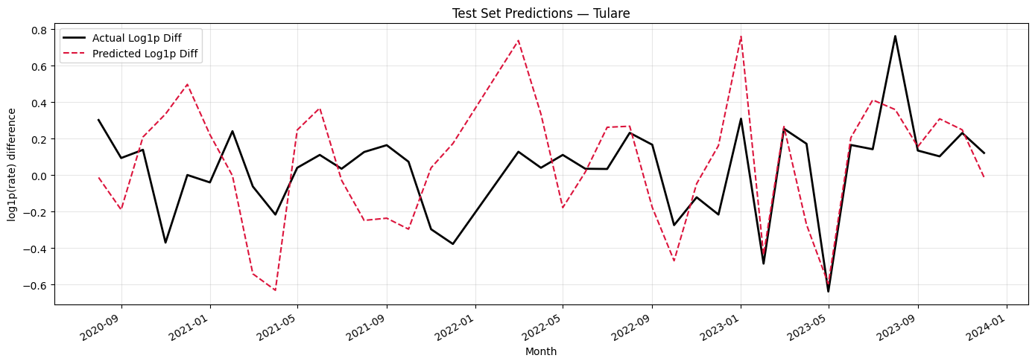
Actual vs Predicted Monthly Rate Changes
September 2020–December 2023 | Log-transformed Differences | County-trained LSTM
RMSE = 0.1743 MAE = 0.1411
These are the per county correlation values for the features vs. the valley fever rate 0.47
Notes:
RMSE=0.17427 MAE=0.14107
I could say the counties that have lower rmse and mae without using target as a feature
- A notable one is fresno?J>
I have been working on the county trained LSTM and testing it on that same county. Here we have San Diego plotted and we believe that our county by county models are more bold in there guesses meaning that they go for the spikes while the aggregate models seems to hover more around the mean in a safer “guess”

Slide 4
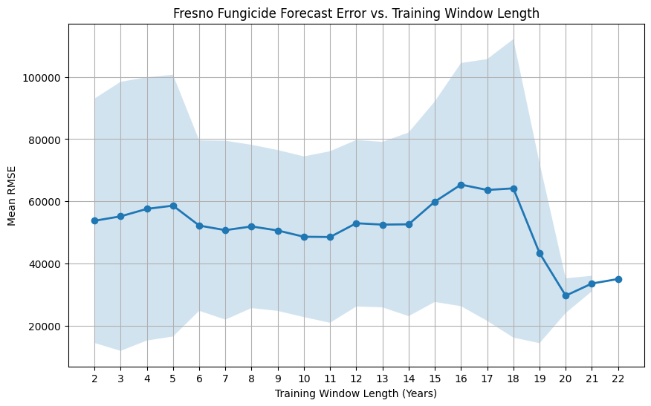
Average RMSE per training window split for fungicide prediction
Notes:
Recall: 2001-2023
Needed to impute the data for 2024 (last year of data)
(Holt-Winters Exponential Smoothing model)
In order to make it more robust, I wanted to determine the optimal number of years I needed to train the prediction model on
So I created windows of size 2-22 years
So for example, size 2 would start at (2001-2003) and then slide to 2002-2004 and so on thru all the years.
I took the RMSE of each window and then took the average of the RMSEs and this is what is plotted
The first thing you might notice is that there is a significant drop off at the end in RMSE, specifically at window size 20,
but this isn’t necessarily the best, since the larger the window size the less folds we’ll actually have
You can see that from length 6-11 the RMSE does not seem to change that much, however,
the change in predicted values is more drastic than it seems on this graph, as I’ll show here

Slide 5
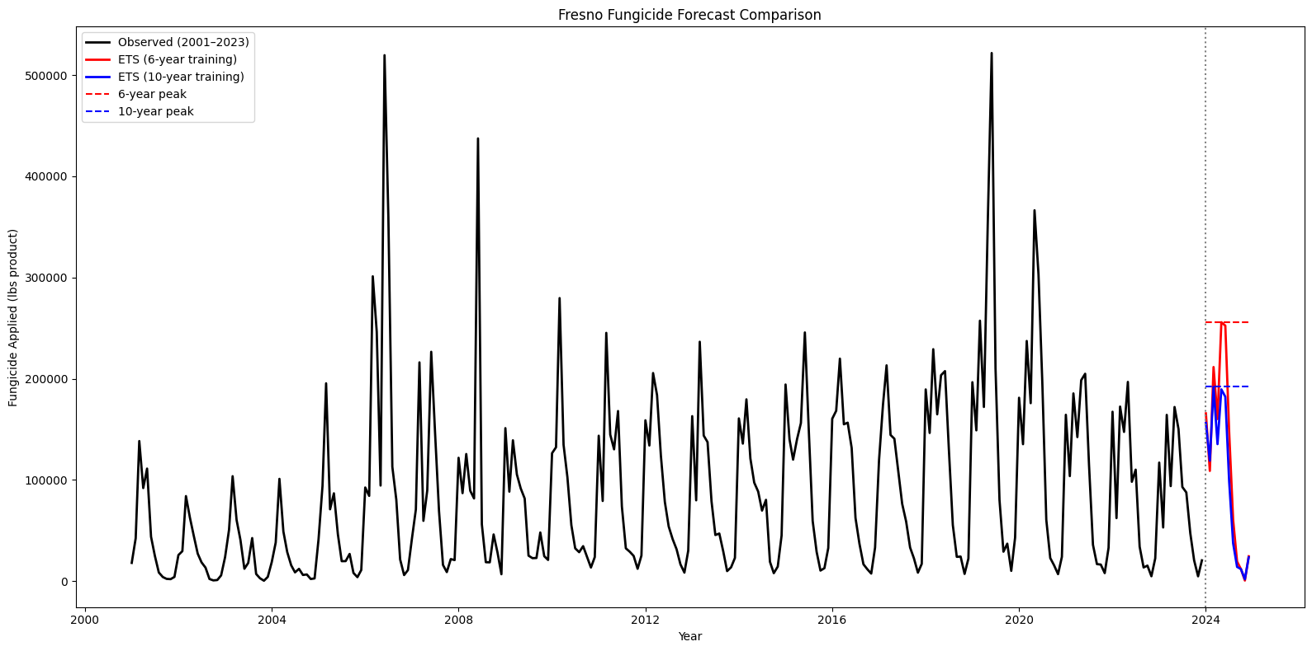
Plotted fungicide predictions based on previous 6 years and 10 years of data
Notes:
Window size of 20-years was emitted
Even though it had the lowest RMSE, it was almost identical to the blue 10-year prediction,
So why use 20 years of training data when we can use 10?

